Slide 1


ETHICS IN ENGINEERING
A Comprehensive Guide for Electrical Professionals

Slide 2



DEFINING ENGINEERING ETHICS
STANDARDS
RESPONSIBILITY
INTEGRITY
Establishing the moral rules and technical standards for the profession.
Accepting the obligation to protect public safety and the environment.
Maintaining honesty in data reporting, design, and business practices.

Slide 3
THE TRUST DEFICIT
Engineering decisions have massive societal impact.
100%
Failures lead to loss of life and economic collapse.
Public trust is the foundation of the license.
Ethical conduct ensures sustainable innovation.
Duty to Public Welfare

Slide 4


SAFETY: THE HIGHEST CANON
Hold paramount the safety, health, and welfare of the public.
Notify proper authorities if judgment is overruled.
Approve only those documents that are safe for use.
Ensure designs are fail-safe and follow rigorous testing.

Slide 5
IEEE PROFESSIONAL CODE
Disclosure: Disclose all potential conflicts of interest.
Fairness: Treat all people fairly regardless of background.
Lifelong Learning: Maintain and improve technical competence.
Honesty: Be truthful in all professional statements and test data.

Slide 6
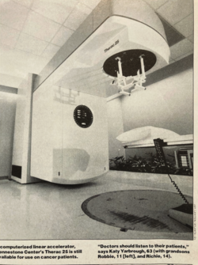
THERAC-25 TRAGEDY (1980s)
A medical accelerator delivered massive radiation overdoses.
Software bugs replaced physical safety interlocks.
A "race condition" in code led to fatal power surges.
Engineers initially ignored technician reports of errors.
The incidents highlight the dangers of engineer overconfidence: engineers dismissed end user reports

Slide 7



LESSON: SOFTWARE SAFETY
REDUNDANCY
USER FEEDBACK
RIGOROUS QA
Never rely solely on software for critical safety functions.
Take all field error reports seriously and investigate deeply.
Document every software change and perform regression tests.

Slide 8

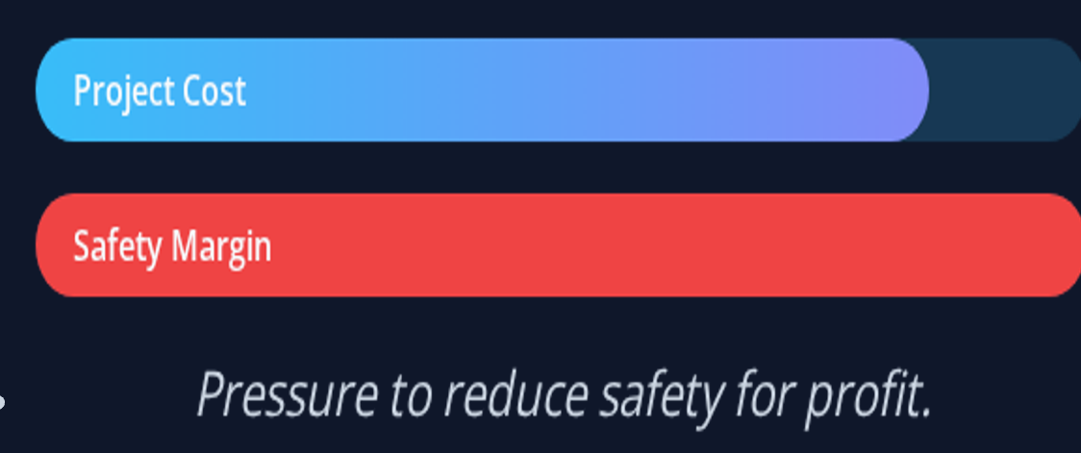

COST VS. SAFETY TRADE-OFFS
Management pushes for 15% cost reduction in hardware.
Removing a surge protector saves $2 per unit.
Potential risk: 1 in 10,000 failure rate over 5 years.
Ethical Question: Is the profit worth the marginal risk?

Slide 9
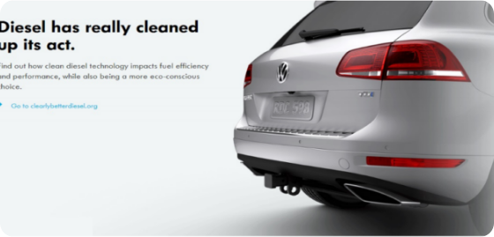

VW EMISSIONS SCANDAL
Engineers designed "defeat devices" in Electronic Control Unit (ECU) code.
Software detected test conditions to lower emissions.
In real-world driving, pollution was 40x the limit.
Resulted in multi-billion dollar fines and jail time.

Slide 10
ALGORITHMIC INTEGRITY
TRANSPARENCY
ACCOUNTABILITY
DUTY TO TRUTH
Black-box logic must not hide illegal or unethical outcomes.
Engineers are responsible for the logic they implement.
Falsifying environmental data violates the social contract.

Slide 11
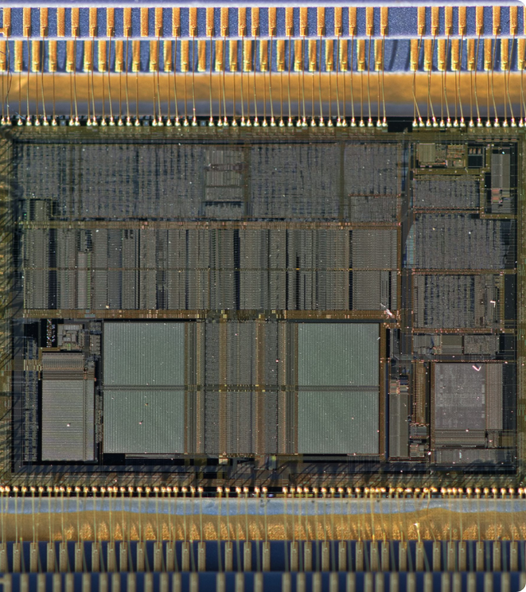
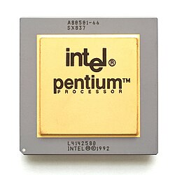
INTEL Floating-Point Divide (FDIV) FLAW
A bug in floating-point division was found by a user.
Intel knew of the flaw but chose not to disclose it.
They claimed the error was rare and "insignificant."
Public backlash forced a $475M total chip recall.

Slide 12
"
"The engineer must be honest about limitations and errors in their work, regardless of the financial cost."
— Professional Responsibility Principle

Slide 13


HARDWARE PRIVACY ETHICS
EEs design the chips that store and encrypt data.
Backdoors for state surveillance are ethical dilemmas.
Designing "planned obsolescence" into device life.
Ethical design prioritizes user data ownership.

Slide 14
INFRASTRUCTURE ETHICS
TARGETING
INFECTION
EXECUTION
ETHIC
PLC systems identified in industrial facility.
Software payload delivered via USB drives.
Sensors spoofed while centrifuges overspun.
The morality of designing digital weapons.

Slide 15
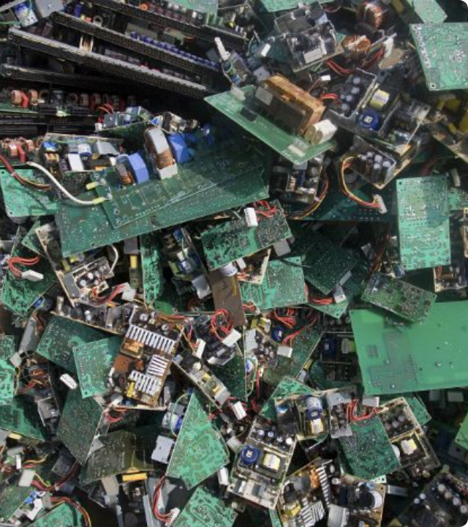
THE E-WASTE CRISIS
Millions of tons of toxic lead and mercury are discarded.
EE designs often make recycling difficult (glued batteries).
Global impact on communities where waste is dumped.
Duty: Design for disassembly and sustainable materials.
Global electronic waste (e-waste) reached approximately 65 million metric tons annually in 2025.

Slide 16
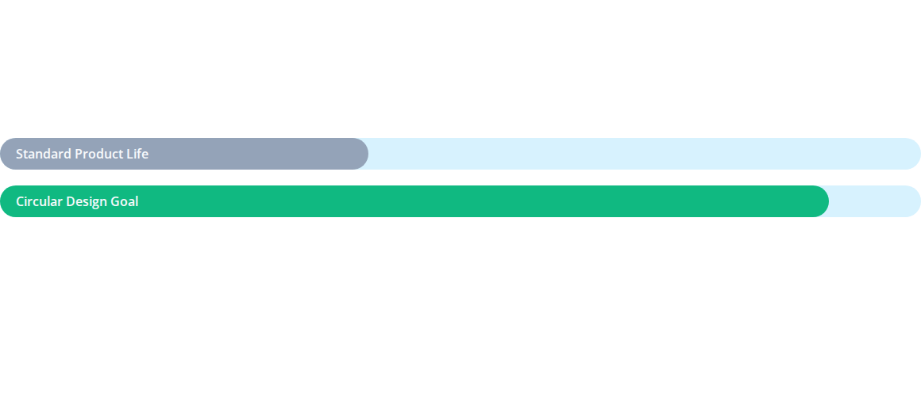
DESIGNING FOR THE FUTURE
Engineers must consider the cradle-to-grave cycle of every circuit board and battery designed.

Slide 17
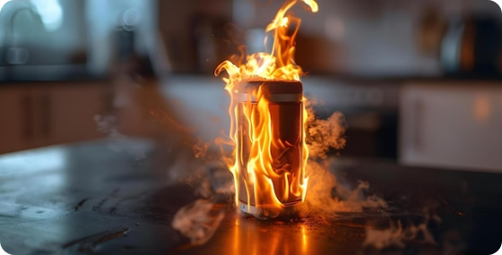

SAMSUNG BATTERY FIRES
Pressure to launch thin phones squeezed battery space.
Internal separators failed under mechanical stress.
Rapid thermal runaway led to explosions and fires.
A failure in checking manufacturing tolerances.
In 2016, Samsung recalled over 2.5 million Galaxy Note 7 smartphones after numerous reports of batteries overheating and catching fire.

Slide 18

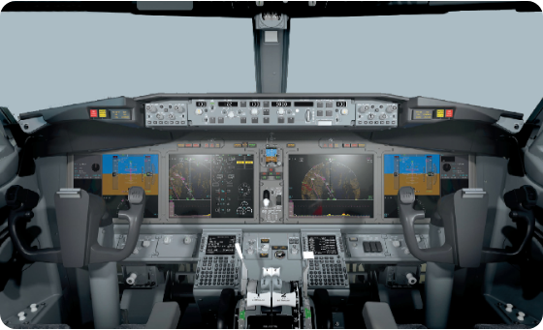
BOEING MCAS FAILURE
Single-point failure: Reliance on one sensor for MCAS.
Software overrode pilots based on bad sensor data.
Crews were not trained on the system to save costs.
Result: Two crashes and hundreds of lives lost.

Slide 19
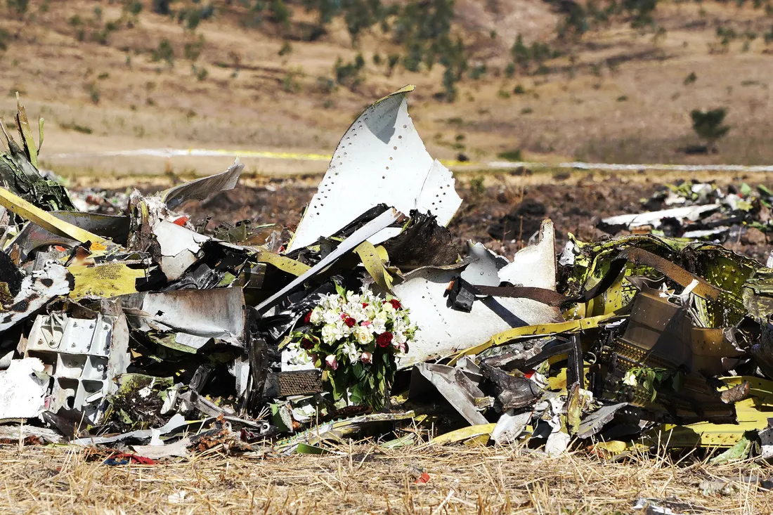
The Boeing 737 MAX tragedy
Two fatal crashes of the aircraft model in 2018 and 2019 that killed a combined 346 people.
The software MCAS was an automated flight control feature designed to prevent the 737 MAX from stalling by pushing the plane’s nose downward.
The system relied on data from a single angle-of-attack (AoA) sensor.
Lack of training

Slide 20
SYSTEM ARCHITECTURE ETHICS
No Single Point of Failure: Especially for critical flight control.
The Pilot/Operator Rule: Humans must always have an override.
Full Disclosure: Safety-critical features shouldn't be "add-ons."
Transparency: Clearly communicate system logic to end-users.

Slide 21
THE "LAUNCH AT ALL COSTS" TRAP
MARGIN OF ERROR
STRESS TESTING
MANAGEMENT DUTY
Never compromise physical tolerances for aesthetic goals.
Simulate worst-case scenarios, not just typical use cases.
EEs must inform CEOs when physical limits are breached.

Slide 22
BIAS IN AUTOMATION
AI models in recruitment and policing show racial bias.
AI training data is often missing information or doesn’t represent everyone fairly.
Ethics: How do we ensure "fair" hardware-software integration?
The "Invisible Hand" problem of neural network weights.

Slide 23
WHISTLEBLOWING PROTOCOL
#1
Identify the technical or ethical violation clearly.
Gather data evidence to support your concern.
Bring concern to immediate management in writing.
Internal Escalation First
Escalate to legal or public if safety is ignored.

Slide 24
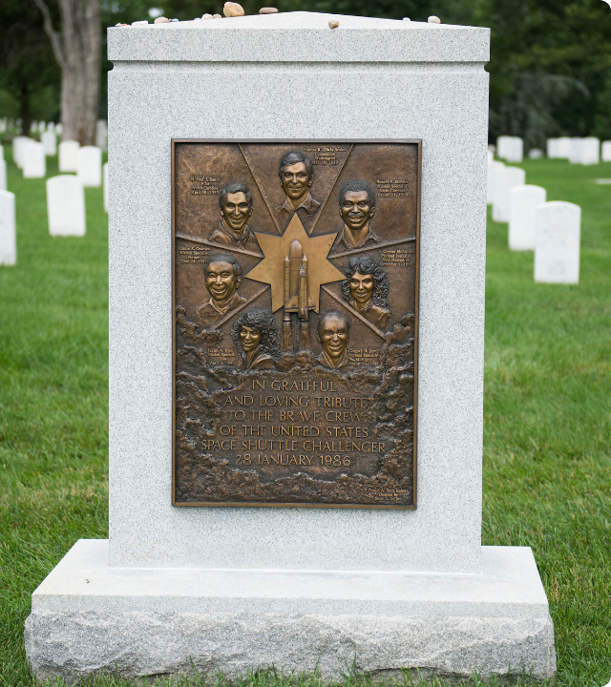
CHALLENGER EXPLOSION
Engineers warned that O-rings fail in freezing cold.
Management pressured them to "take off your engineering hat."
Groupthink and schedule pressure overrode physics.
Resulted in the total loss of ship and crew.

Slide 25
"Never take off your engineering hat for a management decision that involves technical safety."
— Roger Boisjoly (Challenger Engineer)

Slide 26
AVOIDING CONFLICTS OF INTEREST
Refrain from accepting gifts from potential component vendors.
Disclose financial stakes in third-party service providers.
Do not consult for direct competitors on the same tech.
Disqualify yourself from contract decisions involving family.

Slide 27
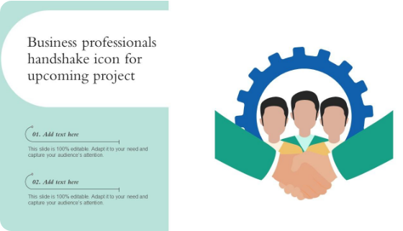

GLOBAL ETHICS & INTEGRITY
Cultural "gifts" can easily cross into illegal bribes.
Foreign Corrupt Practices Act (FCPA) compliance is key.
Facilitation payments for grid access are often unethical.
Build a culture of merit, not kickbacks.

Slide 28
Intellectual Property (IP) AND The EE Designer
PATENTS
ATTRIBUTION
TRADE SECRETS
Respect others' circuit topologies and software patents.
Always give credit to open-source libraries or team members.
Maintain confidentiality when moving between firms.

Slide 29
INCLUSION FOR BETTER DESIGN
Teams with similar backgrounds often overlook important safety and usability issues..
Discrimination violates the fundamental IEEE principle.
Diverse inputs improve system robustness and accessibility.
Mentorship for underrepresented groups builds the profession.

Slide 30


NORTHEAST BLACKOUT (Aug. 2003)
A software bug in monitoring tools blinded operators.
A sagging power line caused a local failure cascade.
Lack of communication led to grid failure for 50M people.
Ethics: Duty to maintain resilient grid communications.

Slide 31
SYSTEM HEALTH MATRIX
Component | Ethical Priority | Redundancy Plan
Grid Sensors | Data Accuracy | Dual-channel Verification
Protection Relays | Instant Trip | Backup Mechanical Breaker
Control Software | Logic Integrity | Watchdog Timers

Slide 32


GREEN GRID ETHICS
Transitioning from fossil fuels is a moral imperative.
Renewables must be integrated without compromising stability.
Equitable access to clean power for all communities.
Reducing energy poverty through engineering innovation.

Slide 33
THE FRONTIERS: BIO-ELECTRONICS
BIO-PRIVACY
HACKING LIFE
AUGMENTATION
Who owns the data from a brain-computer interface?
Security ethics for pace-makers and neural implants.
Addressing the digital divide in human enhancement.

Slide 34
THE ETHICAL DECISION LOOP
ANALYZE
EVALUATE
ACT
REVIEW
Choose the path that holds safety paramount.
Identify stakeholders and technical facts.
Apply IEEE code and safety standards.
Monitor outcomes and adjust protocols.

Slide 35

The University of Virginia (UVA) stands out as the premier institution for engineering ethics resources. It hosts the internationally renowned Online Ethics Center (OEC), which serves as a massive digital library and clearinghouse for STEM ethics resources, case studies, and research

